Slide 1
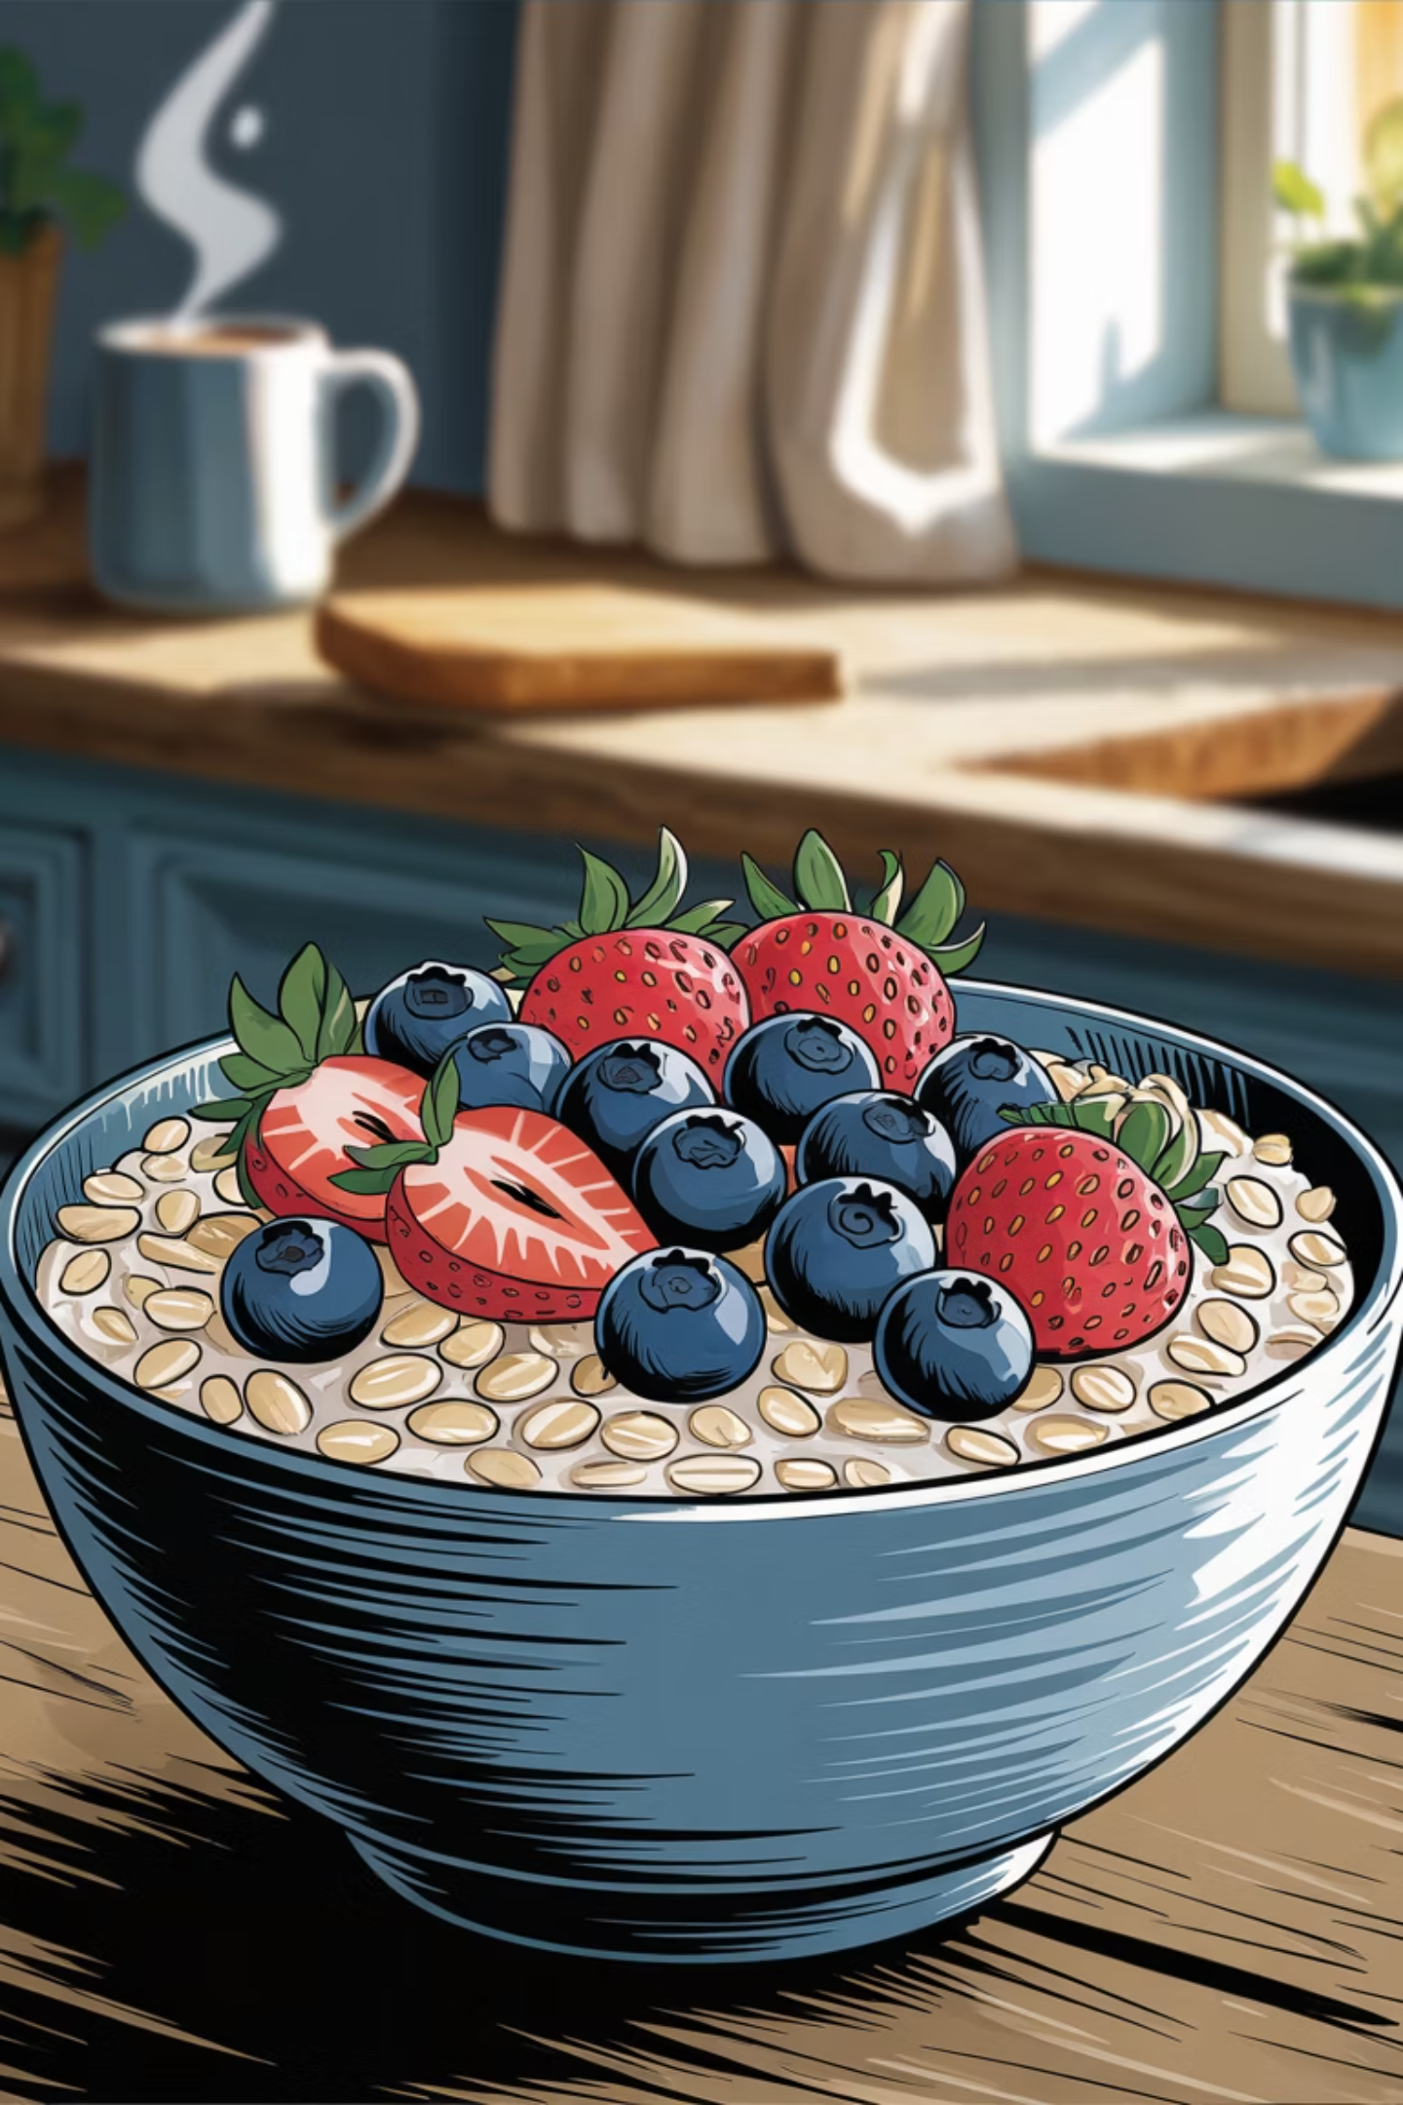

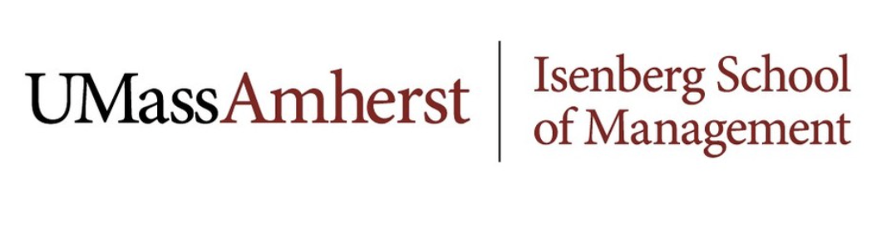
–MUSH Marketing Strategy–
-Building a Functional Breakfast Brand for Long-Term Growth
Created by: Shreyash Lokhare | Prasanna Saudagar | Kunal Pingale

Slide 2




Executive Cover Memo
Most Important Recommendation
Why Action is Needed Now
Next Steps
Competitors like Kodiak and Oats Overnight are stronger in protein and fullness. Without strengthening functional positioning, MUSH risks losing repeat customers after trial.
Shift messaging toward protein, fullness, and morning energy
Use sampling and influencer campaigns to drive trial
Launch subscription and loyalty programs
Track conversion, repeat purchase, and customer lifetime value
Reposition MUSH from a "healthy lifestyle snack" to a "complete functional breakfast solution."

Slide 3

Situation Assessment – Market Context
Breakfast Market Shift
The U.S. breakfast market is moving toward products that are fast, healthy, and functional. Consumers want breakfast that supports their lifestyle and keeps them full.
Core Insight
The opportunity is not just in selling oats. The opportunity is in solving a daily morning problem: "I need something fast, healthy, and filling before my day starts."
High-Protein Foods
Convenience Driver
Consumers increasingly prioritizing protein-rich options
Major factor in food choice decisions
Breakfast Skipping
Clean Label
Many young consumers skip breakfast due to lack of time
Functional nutrition becoming more important

Slide 4

Competitive Landscape
MUSH vs Competitors -
Factor
MUSH
Oats Overnight
Kodiak
Protein
Low
High
High
Convenience
High
Medium
Medium
Clean Label
Strong
Medium
Medium
Satiety
Medium/Low
High
High
Price Value
Weak
Medium
Strong
What MUSH Owns Today
Where MUSH Is Weak
Clean ingredients
Ready-to-eat convenience
Wellness lifestyle appeal
Protein content
Fullness/satiety
Functional breakfast credibility
Price-to-value perception
Strategic Gap: MUSH is attractive, but not yet defensible as a complete breakfast solution.

Slide 5
Target Consumer Segment
Primary Target
Demographics
Busy, health-conscious students and young professionals
Age: 18–34
Lifestyle
Behavior
Busy mornings, classes, work, gym, commuting
Often skips breakfast or chooses quick alternatives
Media Habits
Purchase Need
Instagram, TikTok, influencer content, online reviews
Fast, tasty, high-protein, filling, clean, and affordable enough for repeat use
Why This Segment Matters: This group feels the breakfast problem almost every day. They want convenience, but they also want nutrition that feels worth the price.

Slide 6






Consumer Journey & Decision Making
Problem Recognition
Hungry, rushed, need energy quickly
Information Search
Instagram, TikTok, influencers, grocery shelves, online reviews
Evaluation
Compare protein, convenience, taste, clean ingredients, price
Purchase
Most first purchases are trial-based
Post-Purchase
If not filling or valuable enough, consumers switch quickly
Key Insight: Breakfast is a low-to-medium involvement purchase, but protein and satiety act as minimum requirements. If the product fails on fullness, consumers may reject it even if it is convenient.

Slide 7
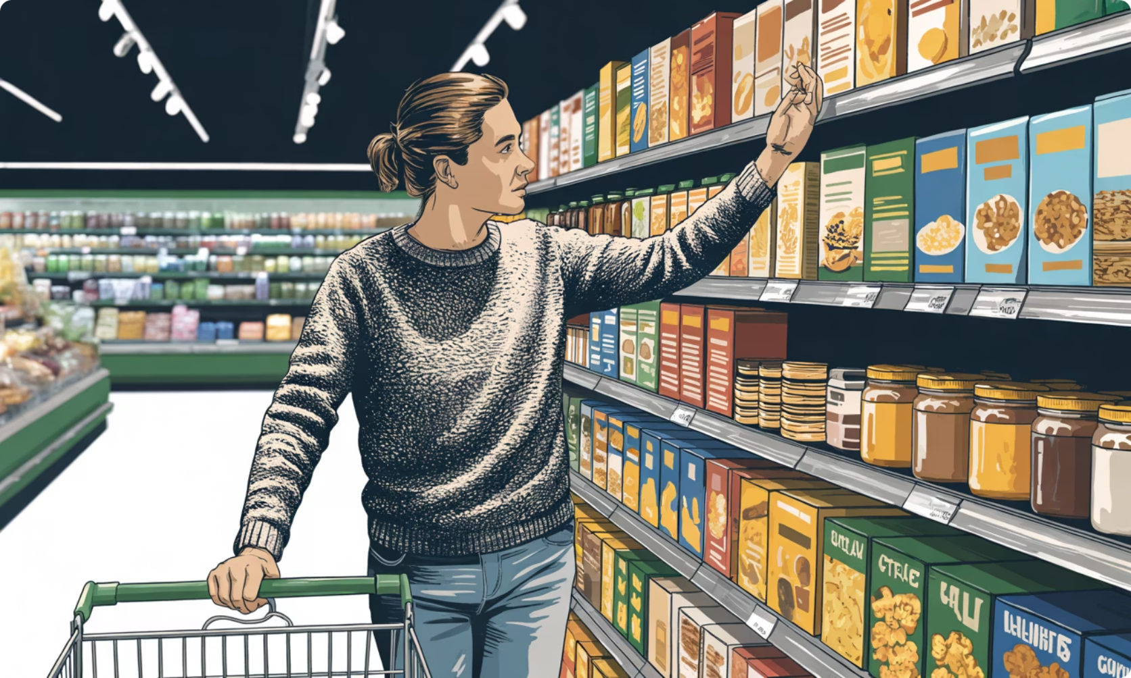
Biggest Strategic Insight
The Real Problem
MUSH's issue is not awareness. The issue is conversion and retention.
–Consumers See MUSH As
Clean
Aesthetic
Convenient
–But They Judge Breakfast Based On
Will this keep me full?
Does it have enough protein?
Will it give me energy?
Is it worth buying repeatedly?
Strategic Insight
Implication
MUSH is positioned emotionally as a wellness brand, but consumers evaluate it functionally as a breakfast meal.
To grow, MUSH must close the gap between lifestyle appeal and functional performance.

Slide 8
Brand Assessment
Brand Story from Multiple Actors-
Actor
Story About MUSH
Strategic Meaning
Firm
Clean, simple, ready-to-eat oats
Strong brand clarity
Influencers
Lifestyle-focused healthy breakfast
Strong awareness
Customers
Convenient but not always filling
Functional gap
Popular Culture
Modern wellness product
Strong cultural relevance
–Brand Culture Summary
–Key Brand Gap
MUSH is a clean, convenient, lifestyle-driven breakfast brand that feels modern and health-conscious, but it is not yet fully owned as a high-performance breakfast solution.
Influencers and the brand focus on lifestyle. Customers focus on value, protein, and satiety.

Slide 9

Marketing Strategy
Strategic Role of Marketing-
Marketing should help MUSH move from awareness to habit formation.
Current Communication
Recommended Communication
Clean eating
Convenience
Wellness
Lifestyle aesthetics
Protein
Satiety
Morning energy
Complete breakfast
Daily routine support
Positioning Statement
For busy, health-conscious students and young professionals, MUSH should be positioned as a clean, ready-to-eat breakfast that provides convenient nutrition and dependable morning energy.
Core Message
"Don't Skip. Stay Full. Stay Sharp."

Slide 10

Integrated Marketing Communication Strategy
-IMC Objective
Convert high awareness into trial, repeat purchase, and daily breakfast habits.
-Advertising
-Social Media
Functional messaging around protein, satiety, energy
Two-way engagement, UGC, comments, challenges
-Sales Promotion
-PR
Sampling, bundles, student discounts
Founder story + nutrition performance story
-Sponsorship
-Direct Marketing
Gyms, universities, wellness events
Personalized offers and repeat-purchase reminders
Key Insight: The plan is not about louder communication. It is about more relevant communication.

Slide 11

Don't Skip. Stay Full. Stay Sharp.
Repositioning MUSH as the essential morning breakfast for busy consumers who need clean, quick, and functional nutrition to start their day.

Slide 12
Campaign Strategy
Digital
Experiential
Promotion
Instagram Reels showing real morning routines, TikTok "My Powered Morning" challenge, influencer stories focused on energy and fullness.
Campus sampling booths, gym partnerships, morning pop-up stations to reach target consumers where they are.
Student discounts, trial bundles, and referral offers to drive initial purchase and repeat behavior.

Slide 13
Product Innovation
MUSH needs stronger functional value to stand out. Competitors offer either convenience or performance—MUSH wins by combining clean convenience with customizable functional nutrition.
Campus + Gym Bundles
Subscription Breakfast Kits
Target high-fit consumers where the breakfast problem happens most.
Protein Boost Add-On Packs
Weekly ready-to-eat packs to build habit and repeat purchase.
Customizable protein based on individual needs.

Slide 14




CRM Strategy: From Product to Relationship
Strategic Shift
1
Breakfast is a repeat category—long-term value comes from retention and purchase frequency, not just first purchase.
2
CRM Priorities
3
Subscription model
Loyalty rewards
Personalized offers
Referral programs
"Powered Morning Club" community
4
5
1
Advocacy
2
Subscription
3
Repeat Purchase
4
Trial
5
Awareness

Slide 15

Implementation Roadmap
Phase 1: Repositioning
Phase 3: Retention
Update messaging and brand communication.
Launch subscription packs and loyalty rewards.
1
2
3
4
Phase 2: Trial Generation
Phase 4: Optimization
Launch sampling, influencer, and student campaigns.
Review KPIs monthly and adjust strategy.
Final Strategic Statement: MUSH already owns clean and convenient. To win long-term, it must own protein, fullness, and breakfast performance.

